Slide 1
Comparison of Kinect2Scratch game-based training and therapist-based training for the improvement of upper extremity functions of patients with chronic stroke: a randomized controlled single-blinded trial
European Journal of Physical and Rehabilitation Medicine 2019
Impact Factor: 2.258

Slide 2
Introduction
1. Approximately 70% of the patients in the acute post-stroke phase experience some upper extremities (UE) disability.
2. High intensity repetitive task training has the greatest benefits to improve UE function but requires extensive guidance from the therapist to deliver treatment, which is both costly and time consuming for the therapists.
3. MIT’s Scratch is a software that is widely used by learner game-developers to develop games.
4. Howell developed Kinect2Scratch, which allows body tracking data to be transferred from the Kinect sensor to scratch.

Slide 3
Introduction
5. The aims of this study:
(a) To develop Kinect2Scratch games to train UE function for patients with chronic hemiplegic stroke.
(b) To compare the effects of Kinect2Scratch games training with equal length sessions of therapist-based training.

Slide 4
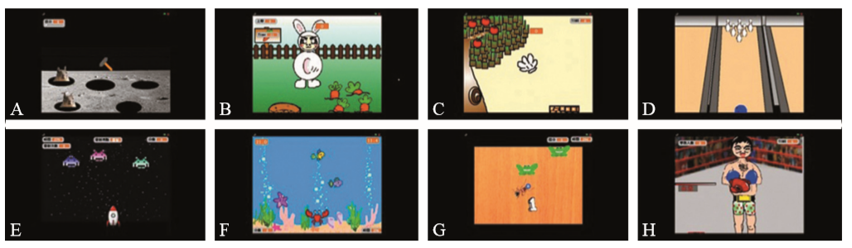
Materials and Methods
1. Game development
(1) Kinect V1
(2) Kinect2Scratch, Scratch 2.0
(3) 8 games (6 unimanual and 2 bimanual)
(a) Whack-a-mole
(b) Harvest carrots
(c) Picking apples
(d) Bowling
(e) Alien attack
(f) Hungry shark
(g) Hungry ant
(h) Boxing

Slide 5
Materials and Methods
2. Participants
(1) Inclusion criteria
(a) Both a clinical and imaging-based diagnosis of a unilateral stroke
(b) More than 6 months prior to the trial
(c) Having active movement of the affected proximal UE
(d) Mini-Mental State Examination Score > 20
(e) Age>18
(2) Exclusion criteria
(a) Bilateral hemispheric or cerebellar (小脑) lesions
(b) Severe aphasia (失语症)
(c) Significant visual field deficits
(d) Hemineglect

Slide 6
Materials and Methods
2. Participants
(3) A total of 33
(a) Kinect2Scratch games group (n = 17)
(b) Therapist-based training group (n = 16)
3. Procedure
(1) The participants were randomized to receive either Kinect2Scratch games or therapist-based training for 30 minutes, with 2 or 3 sessions per week, resulting in 24 sessions over 3 months.
(2) All participants also received training for activity of daily living for 15 minutes and conventional hand function training for 30 minutes.

Slide 7
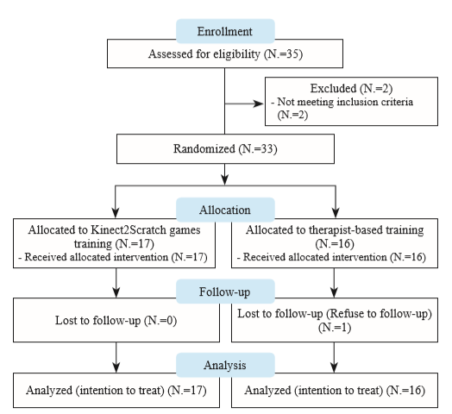

Slide 8
Materials and Methods
4. Kinect2Scratch games group
(1) The participants in the Kinect2scratch group were presented with 3-4 games per training session.
(2) The supervised occupational therapist chose the games and adjusted the levels of difficulty according to the ability and needs of each participant.
5. Therapist-based training group
(1) Patients received specific training for the UE consisting of single joint (shoulder, elbow, forearm) or a combination of multi-joints (such as combining shoulder and elbow).
(2) Each training program was personalized to suit the ability and needs of participants.

Slide 9
Materials and Methods
6. Outcome Measurements
(1) Fugl-Meyer Assessment UE (FMA-UE)
(a) FMA-PROX (shoulder, elbow, and forearm)
(b) FMA-DIS (wrist and hand)
(2) Wolf Motor Function Test (WMFT)
(a) WMFT-TIME (performance time)
(b) WMFT-FAS (functional ability scale)
(3) Motor Activity Log (MAL)
(a) MAL-AOU (affected hand)
(b) MAL-QOM (quality of movement)
(4) Pittsburgh Participation Scale (PPS) for degree of the participant’s engagement
(5) ActiLife 6 software
(a) Amount of the affected UE movement
(b) Total Activity Counts (TAC)
(6) Adverse events

Slide 10
Results
1. After intervention, Kinect2Scratch group showed significant improvements in FMA-UE, FMA-PROX, FMA-DIS, WMFT-TIME, MAL.
2. After intervention, The therapist-based group only showed significant improvements in FMA-UE and FMA-PROX and WMFT-TIME.
3. At follow-up, Kinect2scratch group only showed significant improvements in FMA-UE, FMA-PROX and WMFT-TIME.
4. At follow-up, therapist-based group showed significant improvements in FMA-UE and PROX and WMFT (TIME and FAS).
5. The level of participation was higher in the Kinect2Scratch group than in the therapist-based group.

Slide 11
Results
6. The Kinect2Scratch group showed significantly higher activity counts of the affected UE compared with the therapist-based group (5239.33 vs. 2877.25).

Slide 12
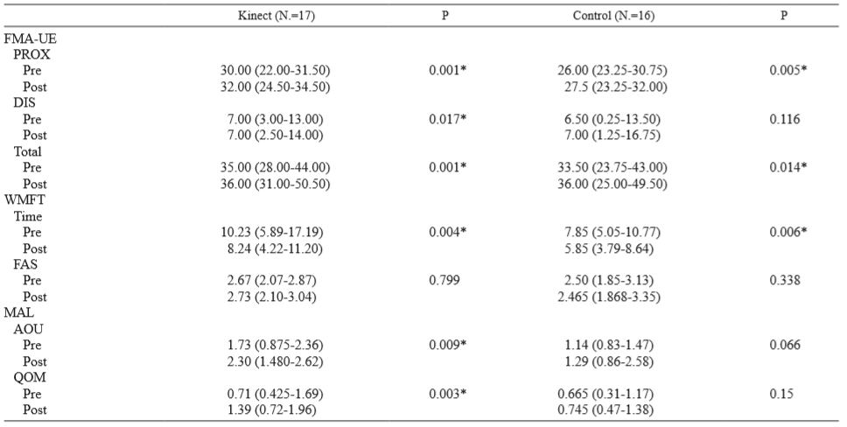

Slide 13
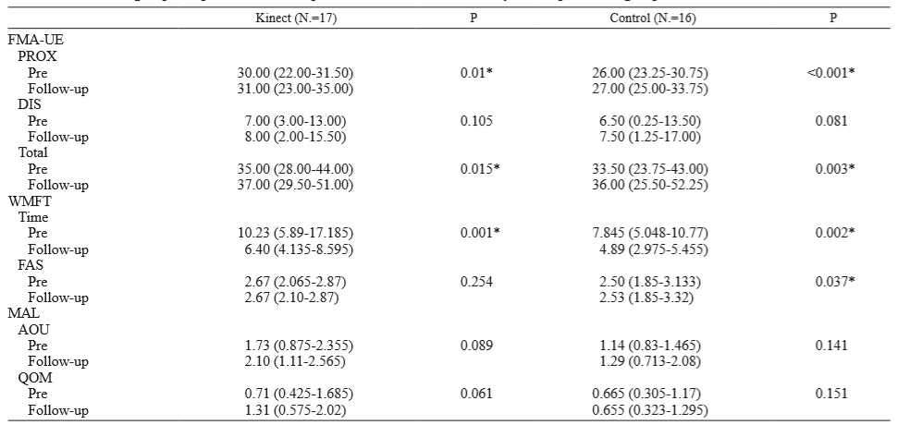

Slide 14
Discussion
1. Virtual reality may be more beneficial in improving UE function when used as an adjunct to the usual care to increase overall therapy time.
2. Our study found that the amount of movement of the affected UE in the Kinect2Scratch group was nearly twice the amount in the therapist-based therapy. However, this did not translate into significantly greater improvement of UE function.
3. The total dose (12 hours of training) may not be adequate, a longer intervention period may potentially provide a different result.
4. The two groups underwent only 30 minutes of different trainings during each 75-minute session. The relatively short duration of training may be another reason why between-group differences were not seen.

Slide 15
Conclusion
1. Kinect2Scratch game therapy is a feasible intervention, well-accepted by patients with chronic hemiplegic stroke.
2. The use of Kinect2Scratch games may serve as a complementary strategy to conventional therapy to decrease the therapists’ workload.

